Slide 1

LSTM: MASTERING LONG-TERM DEPENDENCIES
A concise exploration of architecture, gates, and the power of selective memory.

Slide 2

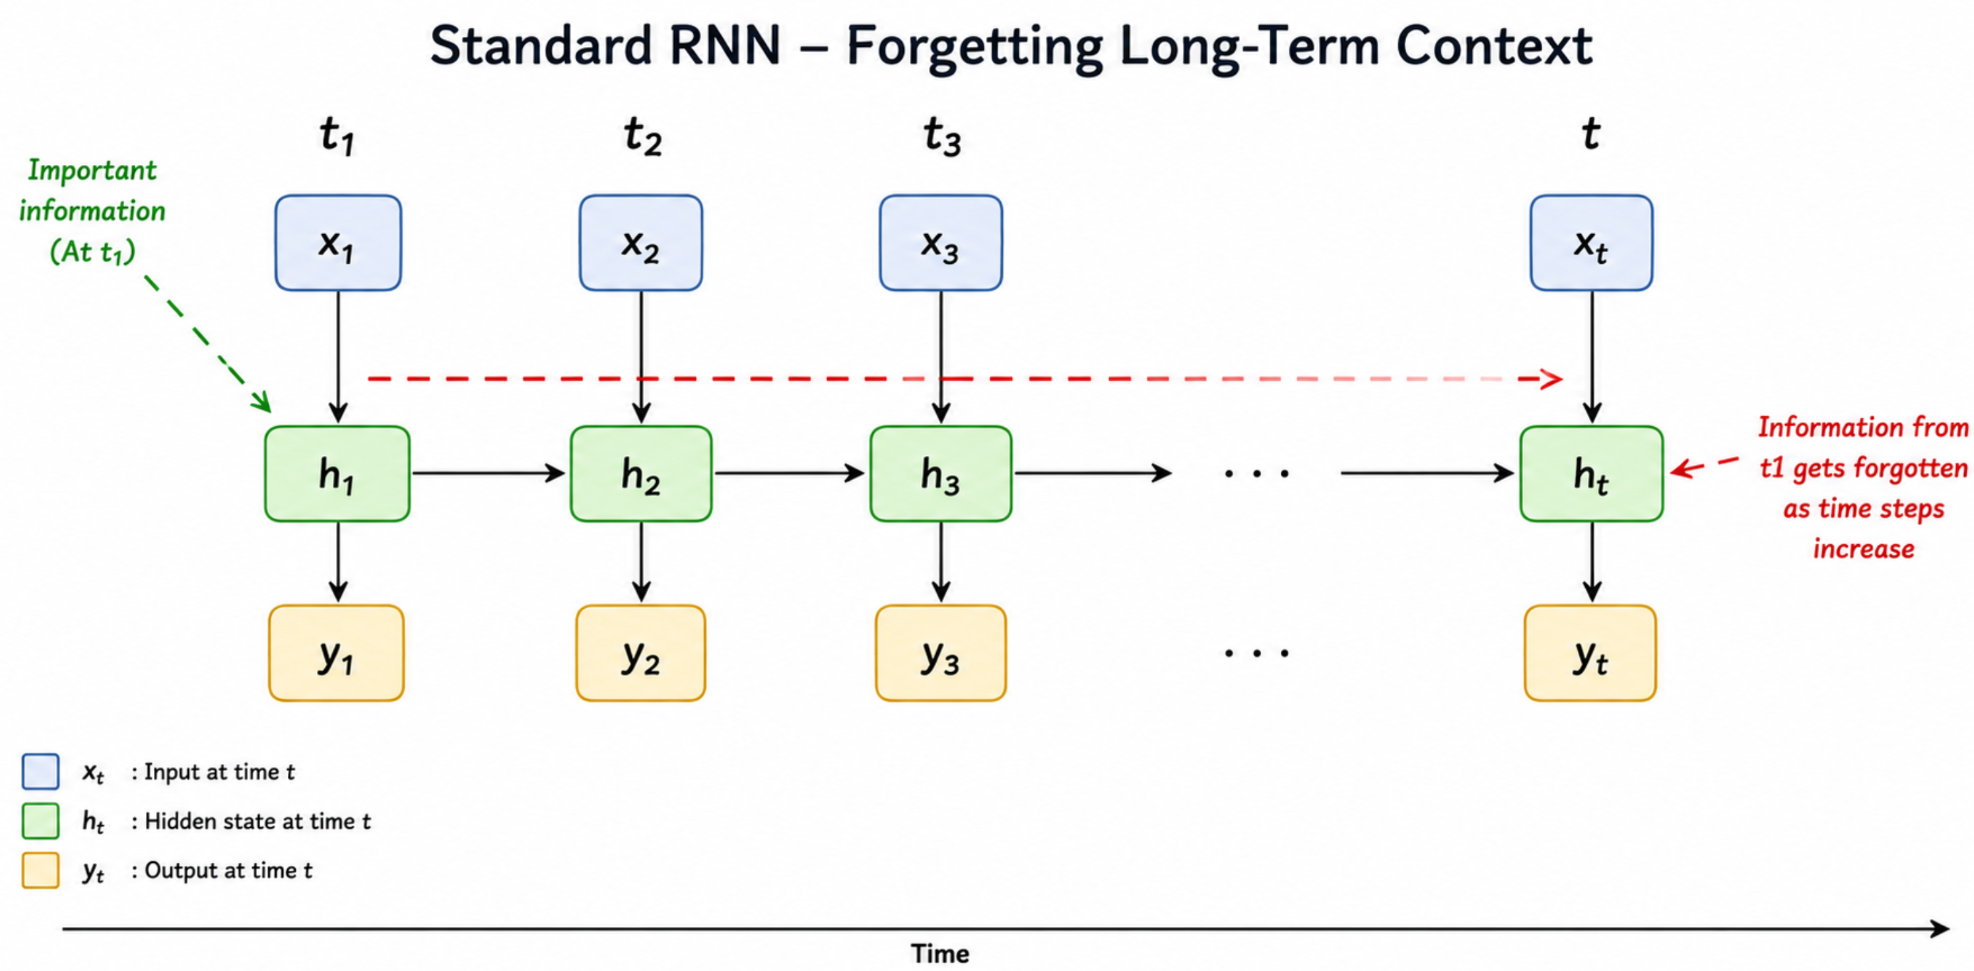
THE CHALLENGE OF SEQUENTIAL DATA
SEQUENCE LIMITS
Standard RNNs struggle with long-term dependencies as information fades over time.
VANISHING GRADIENTS
Gradients shrink exponentially during backpropagation, preventing effective learning.
THE NEED
A mechanism to selectively remember important signals and forget noise.

Slide 3

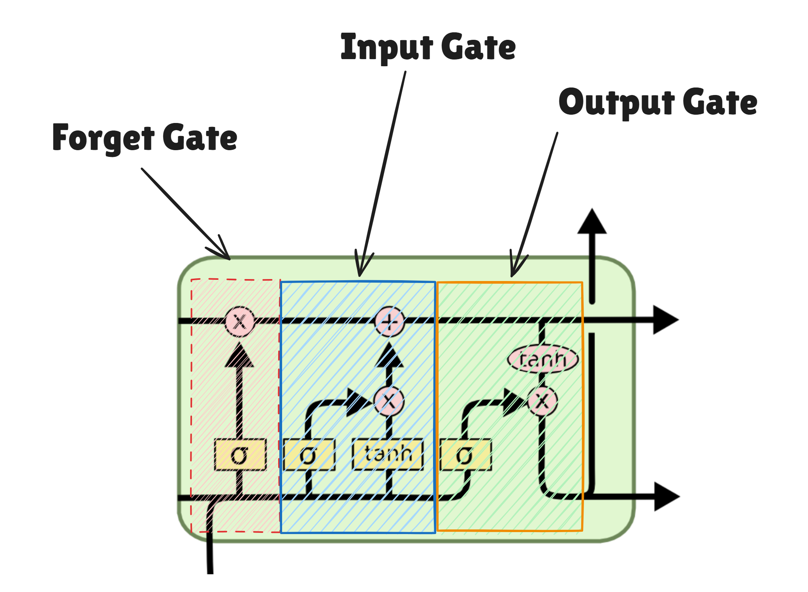
INTRODUCING LSTM ARCHITECTURE
SPECIALIZED RNN
Designed specifically to overcome long-term dependency challenges in sequential data.
CORE INNOVATION
Introduces a memory cell that maintains its state over time, controlled by three gates.
SELECTIVE MEMORY
Learns to protect and update information through mathematical gating mechanisms.

Slide 4
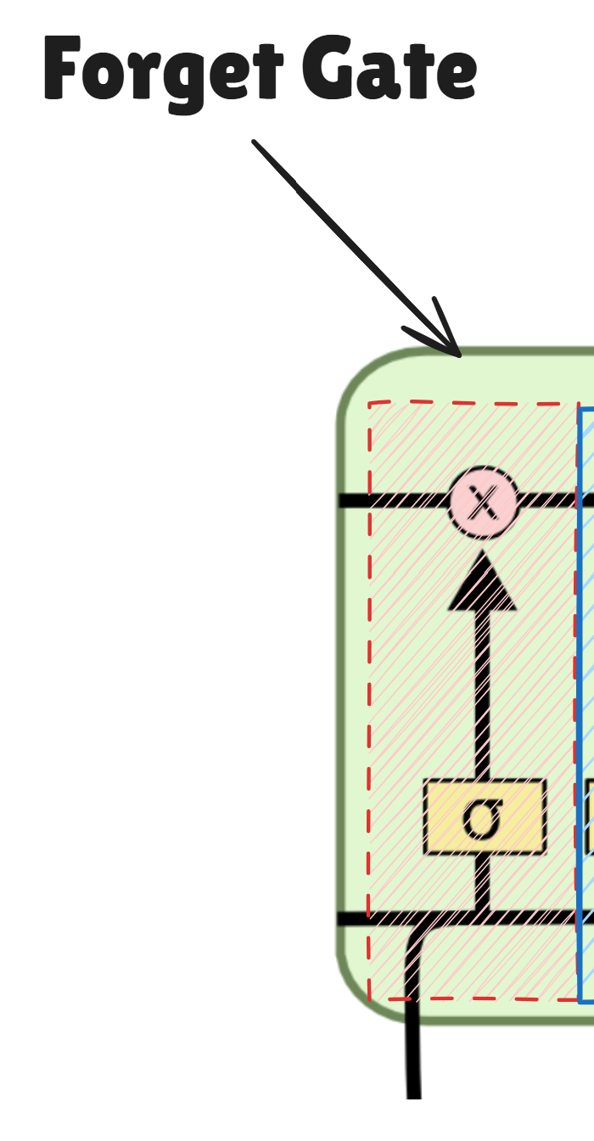
GATE 1: THE FORGET GATE
SELECTIVE DISCARDING
Decides which information from the previous cell state is no longer relevant and should be removed.
SIGMOID ACTIVATION
Outputs a value between 0 (completely forget) and 1 (completely keep) for each number in the cell state.
INPUT PROCESSING
Considers the previous hidden state (h
_{t-1}
) and the
current input (x
_{t}
) to make its decision.

Slide 5
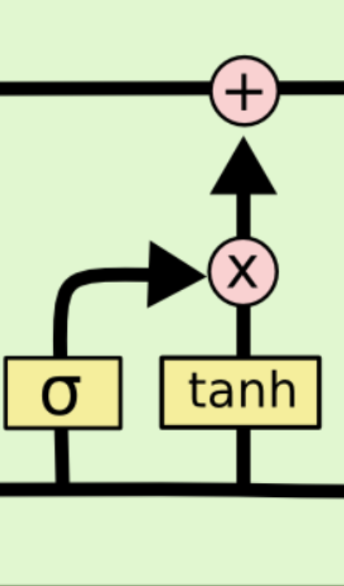
GATE 2: THE INPUT GATE
SELECTION LAYER
A sigmoid layer decides which values in the cell state will be updated (0 to 1).
CANDIDATE GENERATION
A tanh layer creates a vector of new candidate values to be added to the state.
STORAGE DECISION
Combines these two layers to determine exactly what new information is stored.

Slide 6
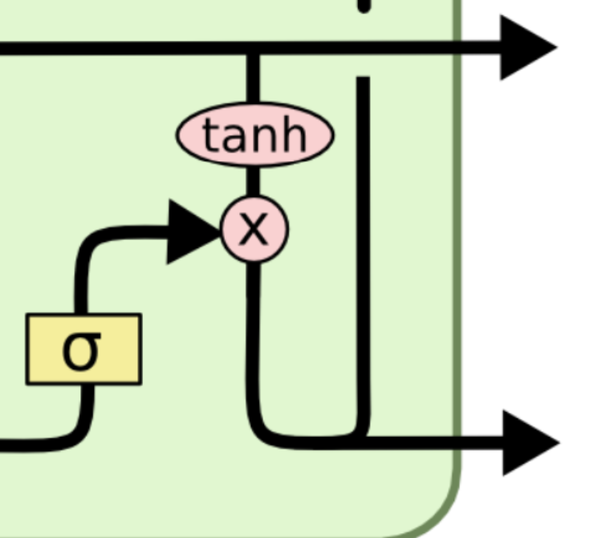
GATE 3: THE OUTPUT GATE
FILTERING STATE
Decides what parts of the cell state are relevant for the current output.
SIGMOID LAYER
Uses the current input and previous hidden state to determine how much information from the cell state is output.
TANH TRANSFORMATION
The cell state is transformed using tanh, then filtered by the sigmoid to produce the hidden state.

Slide 7
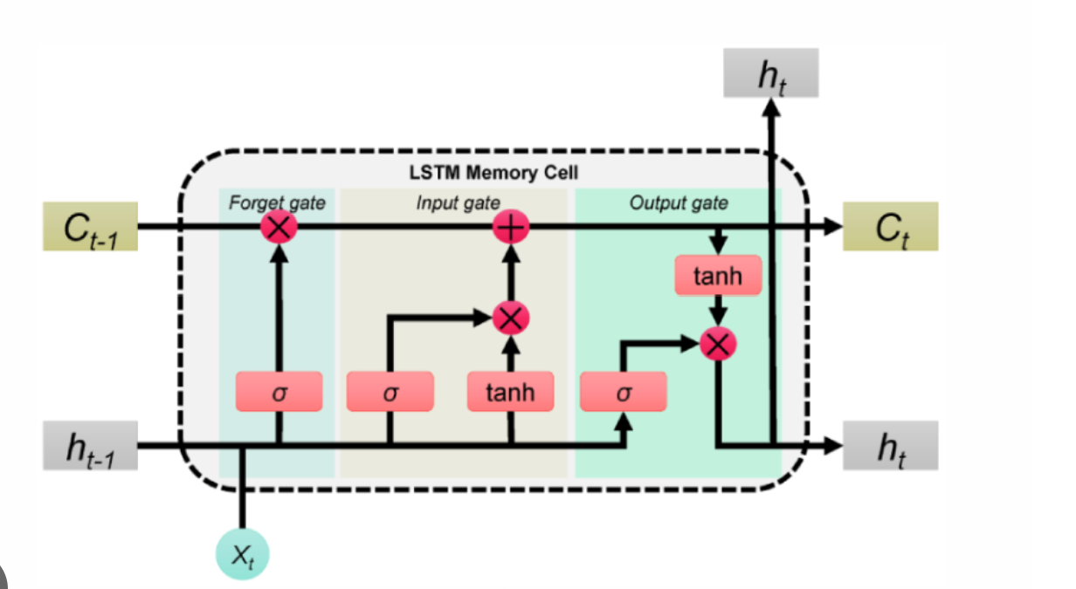
WHY LSTM WINS
PERSISTENT MEMORY
SELECTIVE FOCUS
Intelligently ignores noise and retains key signals through its unique gating mechanism.
Successfully bridges long time gaps in data, retaining context where standard RNNs fail.
ROBUST ARCHITECTURE FOR COMPLEX TASKS

